Slide 1
HR Analytics Presentation by Mangesh Thakare(P-33/G-01)

Slide 2
KPIs
1)Average attrition rate for all department
2)Average hourly rate of male research scientist
3)Attrition rate vs Monthly income Stats
4) Department wise Total working years
5) Job Role Vs Work life balance
6) Attrition rate Vs Year since last promotion relation

Slide 3
Tools Used
Microsoft Excel
SQL
POWER-BI
TABLEAU

Slide 4
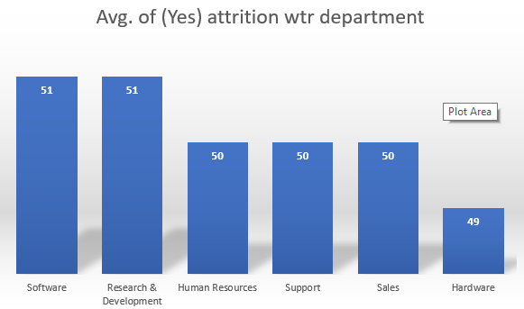
Implementation using Excel

Slide 5
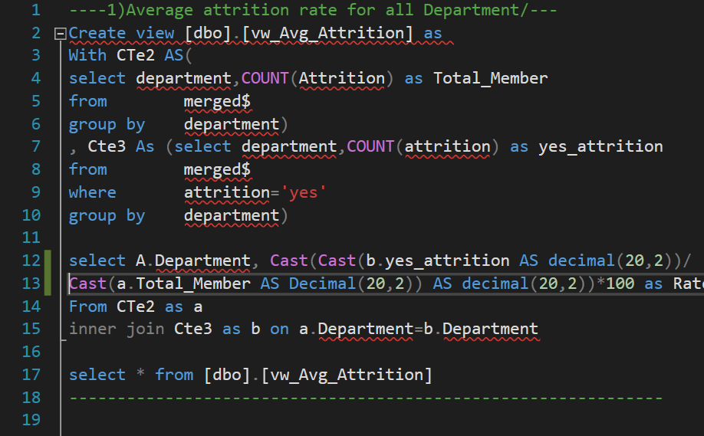
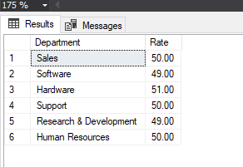
Attrition Rate for all departments
Implementation using SQL

Slide 6
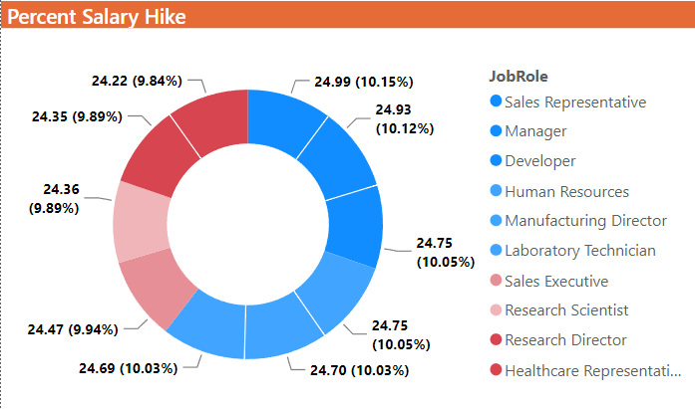
Conclusion of KPI
Salary Hike
Relationship satisfaction

Slide 7
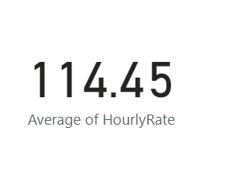
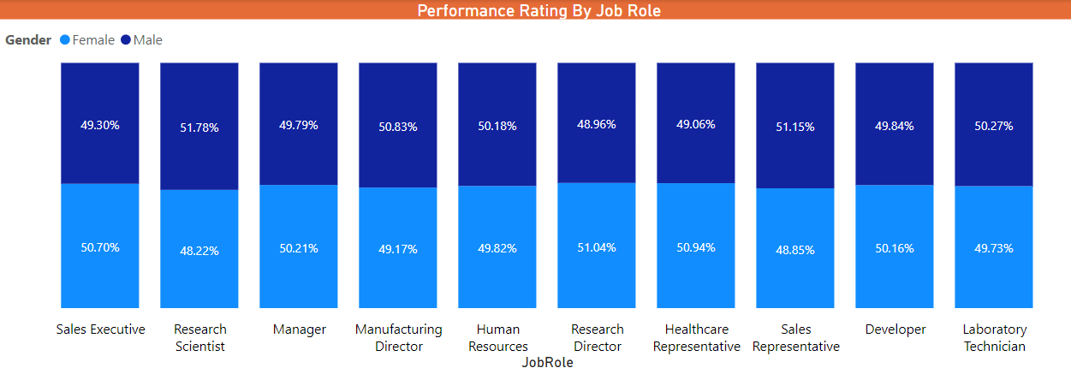
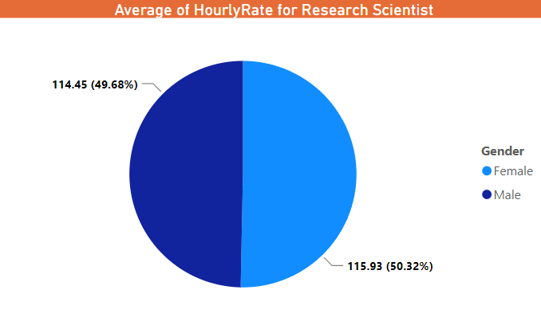
Average Hourly rate of Male Research Scientist

Slide 8
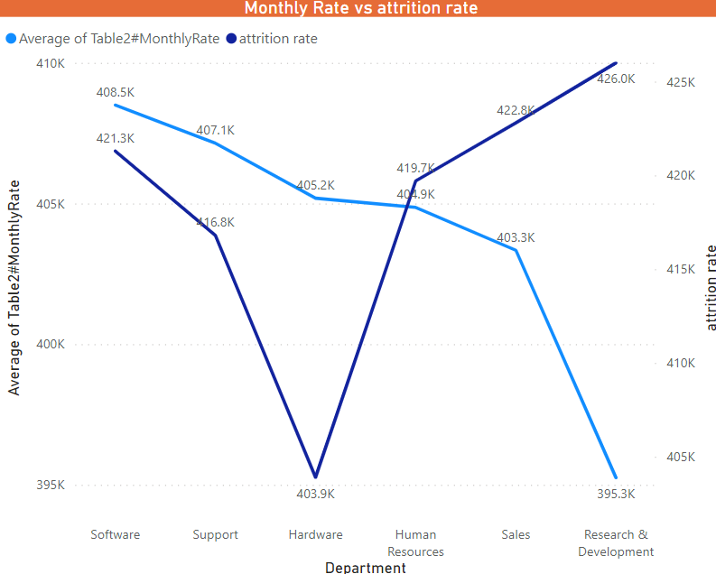
Attrition rate vs Monthly income Stats
Attrition rate in highest in Research & Development, sales and Monthly Rate is inversely proportional to Attrition rate
Because the salary Hike is low in research and development
Work life balance is also not so good in both this departments

Slide 9
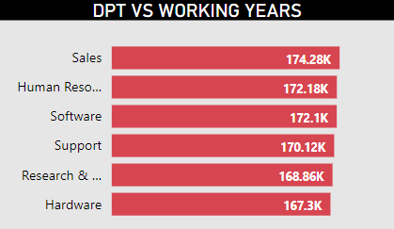
Department wise Total working years
Total working Years Lowest in Hardware Department
Job Statisfaction & Environment Statisfaction lowest in Hardware Department

Slide 10
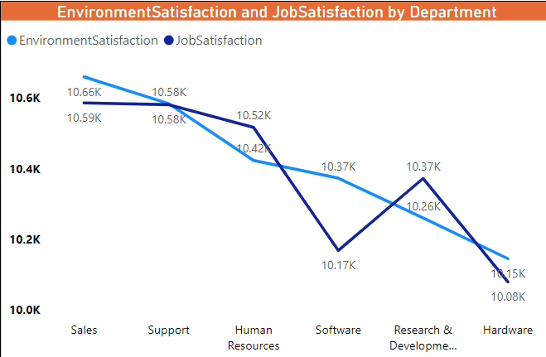
Conclusion Department wise Total working years

Slide 11
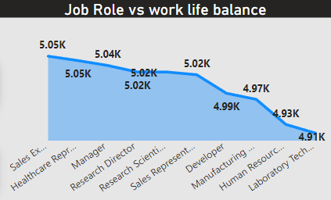
Job Role Vs Work life balance
Job role vs Work life Balance is lowest in labtorary Technicans is lowest
As well as their Performance is also lowest compared to other department

Slide 12
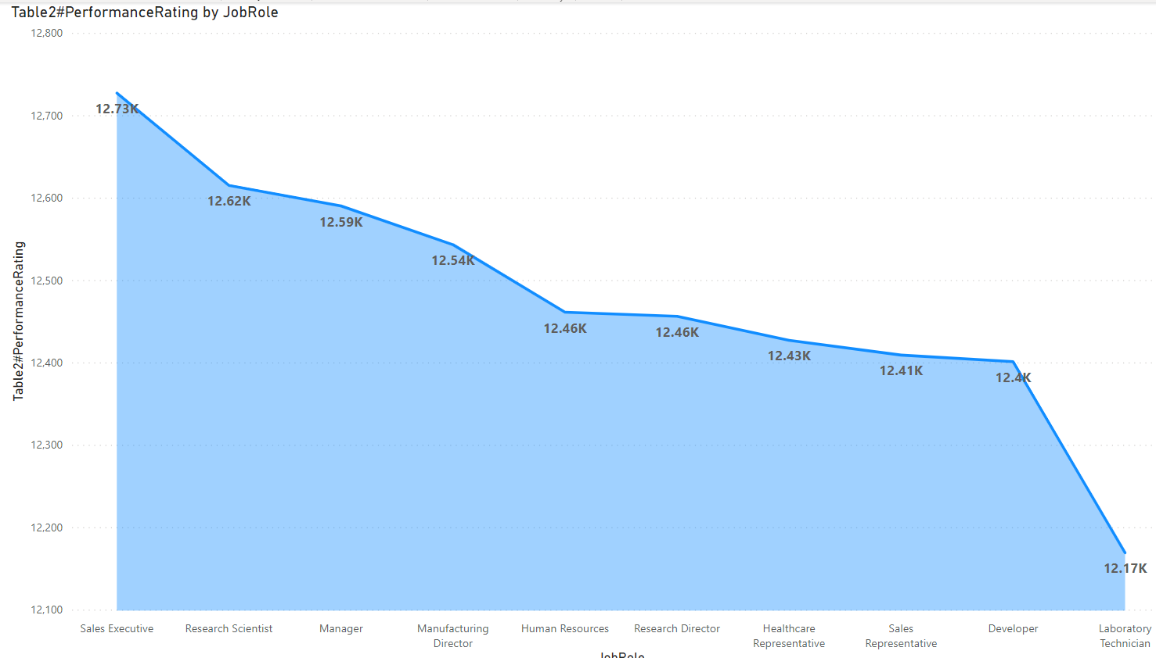
Conclusion Job Role Vs Work life balance

Slide 13
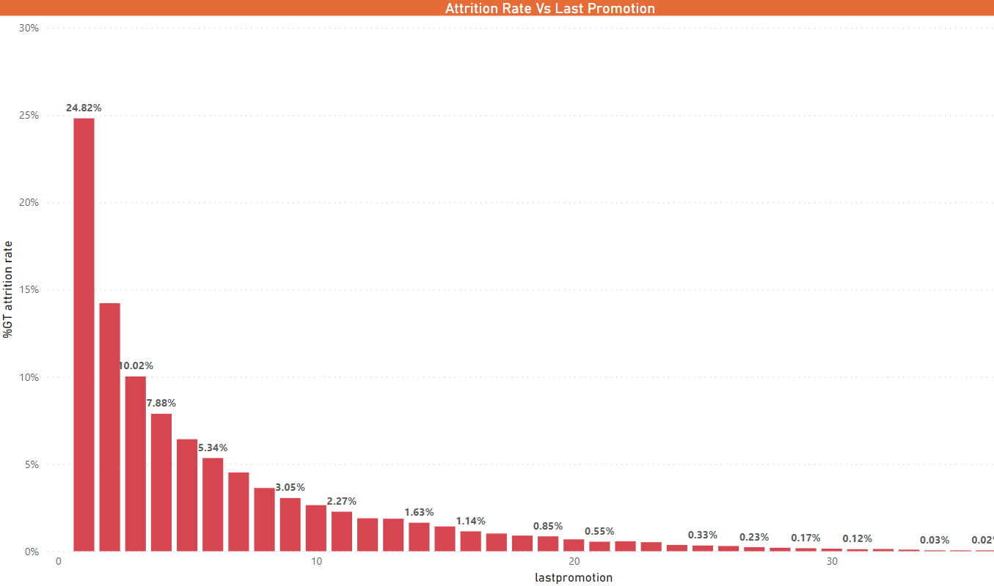
Attrition rate Vs Year since last promotion relation
Attrition late is highest in the first 10 years as the bar graphs shows
Most of the attrition rate since the last promotion is in research and development
Because the work life balance is poor and job statisfaction is also poor as per the data

